Slide 1
Ethical and Social implications in AI
AI for Business

Slide 2

https://www.thispersondoesnotexist.com/

Slide 3
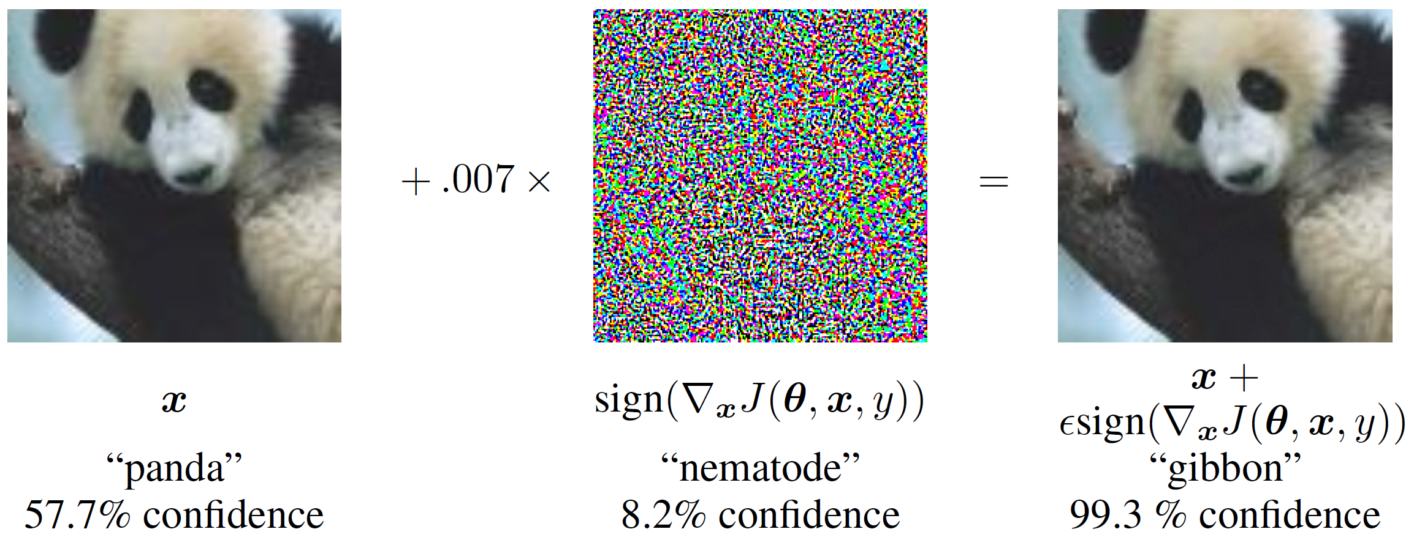
Machine learning is still brittle…
Ian J. Goodfellow, Jonathon Shlens, Christian Szegedy. Explaining and Harnessing Adversarial Examples. ICLR 2015
https://arxiv.org/abs/1412.6572

Slide 4
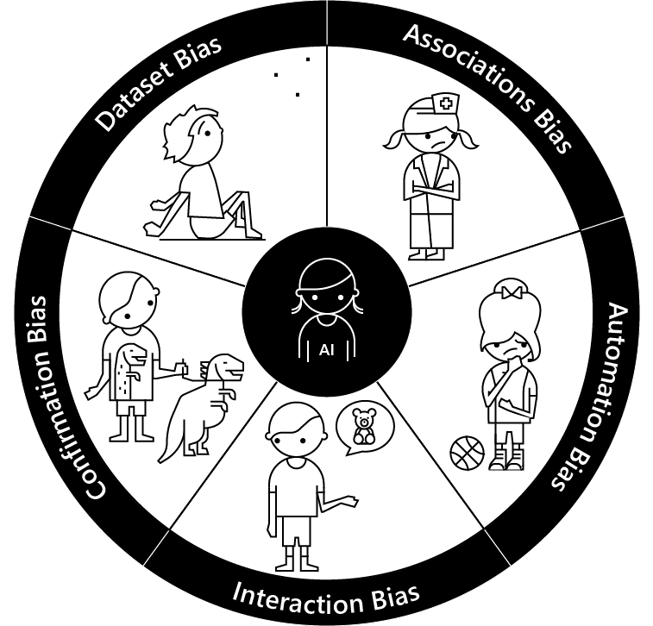
Bias
Dataset bias – When the data used to train machine learning models doesn’t represent the diversity of the customer base.
Association bias – When the data used to train a model reinforces and multiplies a cultural bias.
Automation bias – When automated decisions override social and cultural considerations.
Interaction bias – When humans tamper with AI and create biased results.
Confirmation bias – When oversimplified personalization makes biased assumptions for a group or an individual.
https://medium.com/microsoft-design/how-to-recognize-exclusion-in-ai-ec2d6d89f850

Slide 5
Ethical Implications
Bias and Fairness:
Algorithmic Bias: AI systems can perpetuate and even exacerbate existing biases in data, leading to unfair outcomes in areas such as hiring, lending, and law enforcement.
Equity and Inclusion: Ensuring AI systems are designed and used in ways that are inclusive and equitable is a major challenge.

Slide 6
Ethical Implications
Privacy and Surveillance:
Data Privacy: AI systems often require large amounts of data, raising concerns about how personal data is collected, stored, and used.
Surveillance: AI technologies can be used for mass surveillance, potentially infringing on individual privacy and civil liberties.

Slide 7
Ethical Implications
Transparency and Accountability:
Black Box Nature: Many AI models, particularly deep learning systems, operate as "black boxes," making it difficult to understand their decision-making processes.
Accountability: Determining who is responsible for AI-driven decisions, especially in cases of harm or error, is a critical ethical concern.

Slide 8
Ethical Implications
Autonomy and Consent:
Autonomous Systems: As AI systems become more autonomous, questions arise about how much control and oversight humans should retain.
Informed Consent: Ensuring that individuals understand and consent to the ways in which AI technologies use their data or affect their lives.

Slide 9
Ethical Implications
Non-Ethical Use of AI:
Weaponization: The development of AI for military purposes raises significant ethical questions about the role of autonomous weapons in warfare.
Manipulation and Deception: AI can be used to create deepfakes and other forms of digital deception, undermining trust in information and media.

Slide 10
Social Implications
Social Interaction and Human Relationships:
Human-AI Interaction: The integration of AI into everyday life can change how people interact with technology and each other, raising questions about the nature of human relationships and communication.
Mental Health: The impact of AI on mental health, through social media algorithms, virtual assistants, and other applications, is an area of concern.

Slide 11
Social Implications
Cultural and Societal Norms:
Norm Shaping: AI technologies can influence cultural norms and societal values, sometimes in ways that are not immediately apparent.
Global Disparities: The development and deployment of AI can widen the gap between technologically advanced and less advanced regions, impacting global inequality.

Slide 12
Social Implications
Employment and Economic Impact:
Job Displacement: Automation and AI can lead to job displacement in various sectors, requiring significant efforts in retraining and reskilling the workforce.
Economic Inequality: The benefits of AI might be unevenly distributed, potentially exacerbating economic inequality.

Slide 13
Social Implications
Governance and Regulation:
Policy and Regulation: The rapid development of AI poses challenges for policymakers to create appropriate regulatory frameworks that balance innovation with protection of public interest.
International Cooperation: Coordinating AI policies at an international level to address cross-border issues such as data privacy, cybersecurity, and ethical standards.

Slide 14
Social Implications
Education and Literacy:
Digital Literacy: As AI becomes more prevalent, ensuring that the public has the necessary digital literacy to understand and engage with AI technologies is crucial.
Curriculum Changes: Educational systems need to adapt to prepare future generations for a world where AI is ubiquitous.

Slide 15
Mitigating Ethical and Social Implications
To address these ethical and social implications, several approaches can be taken:
Ethical AI Frameworks: Developing and adhering to ethical guidelines and principles for AI development and deployment.
Inclusive Design: Ensuring diverse teams are involved in AI development to mitigate biases and design inclusive systems.
Transparency Measures: Implementing transparency and explainability in AI systems to build trust and accountability.
Regulatory Oversight: Establishing robust regulatory frameworks that keep pace with technological advancements.
Public Engagement: Engaging with the public to understand their concerns and perspectives on AI, fostering a participatory approach to AI governance.

Slide 16

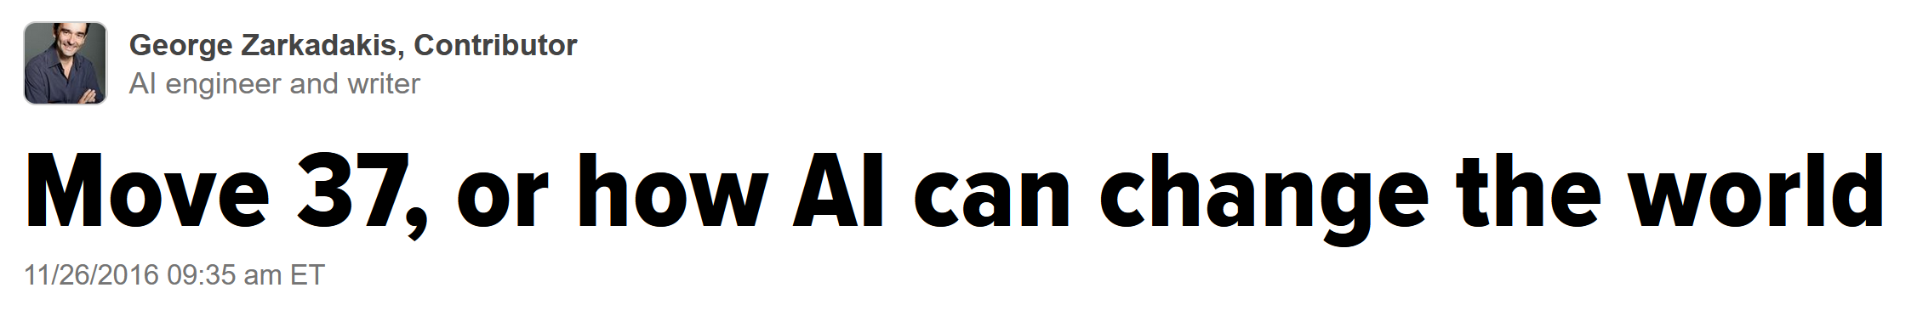

How to Evaluate AI Systems?
https://www.huffpost.com/entry/move-37-or-how-ai-can-change-the-world_b_58399703e4b0a79f7433b675

Slide 17
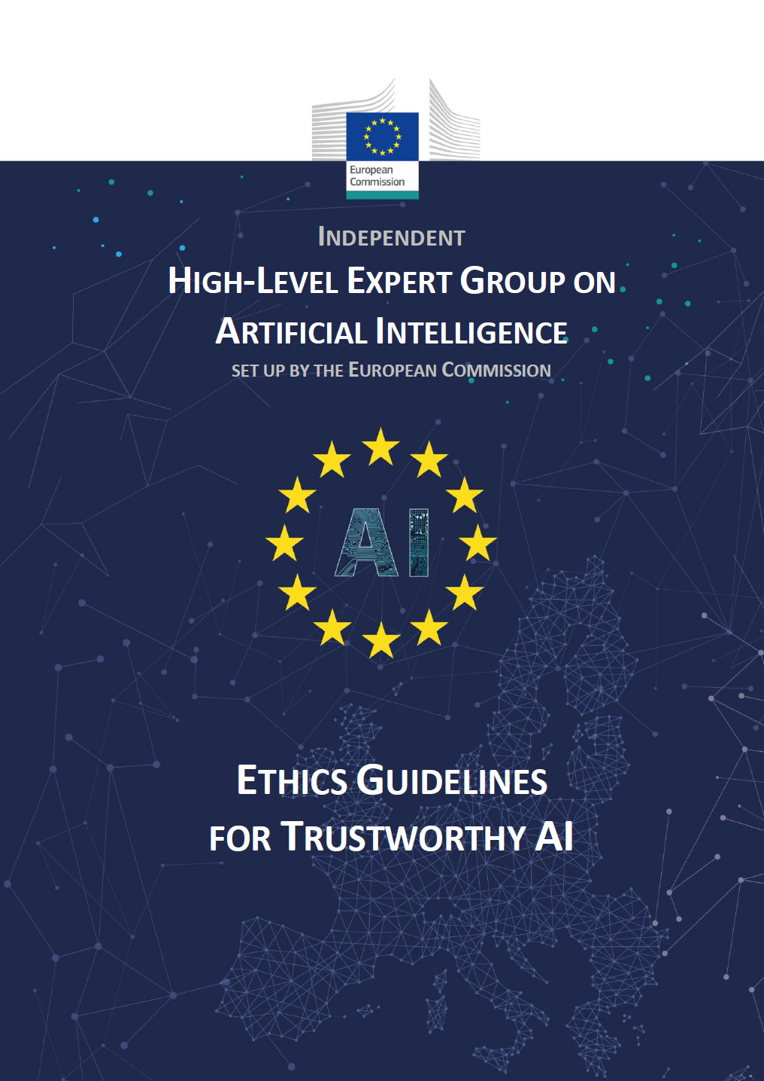
Ethics Guidelines for Trustworthy AI – Overview
Human-centric approach: AI as a means, not an end
Trustworthy AI as our foundational ambition, with three components
Lawful AI
Ethical AI
Robust AI
Three levels of abstraction
from principles (Chapter I)
to requirements (Chapter II)
to assessment list (Chapter III)
https://ec.europa.eu/digital-single-market/en/news/ethics-guidelines-trustworthy-ai

Slide 18




Ethics Guidelines for Trustworthy AI – Principles
4 Ethical Principles based on fundamental rights
Respect for human autonomy
Prevention of harm
Fairness
Explicability
Augment, complement and empower humans
Safe and secure. Protect physical and mental integrity.
Equal and just distribution of benefits and costs.
Transparent, open with capabilities and purposes, explanations
https://ec.europa.eu/digital-single-market/en/news/ethics-guidelines-trustworthy-ai

Slide 19
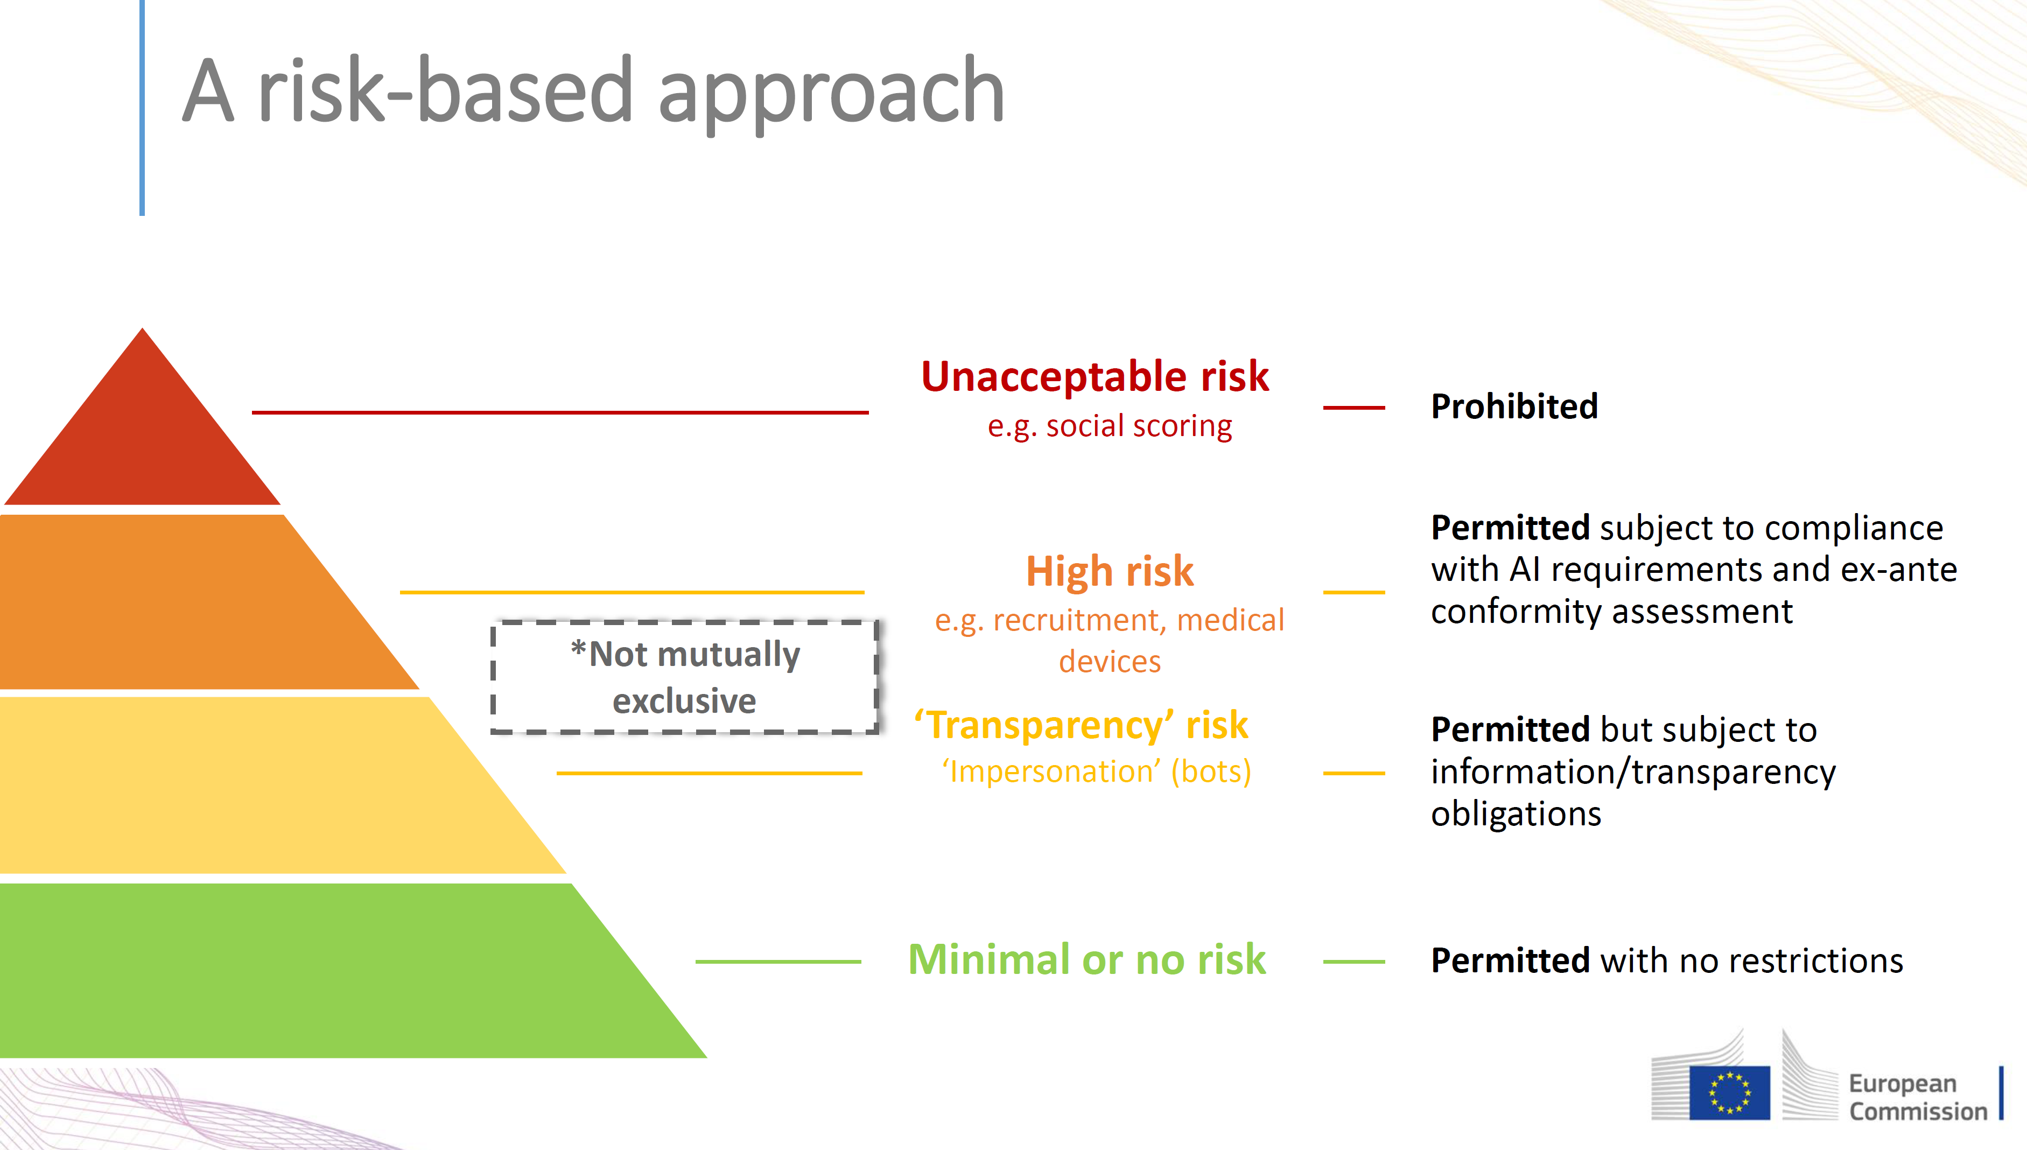

Slide 20
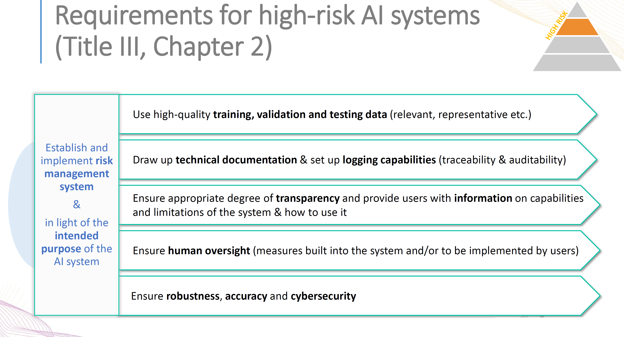

Slide 21
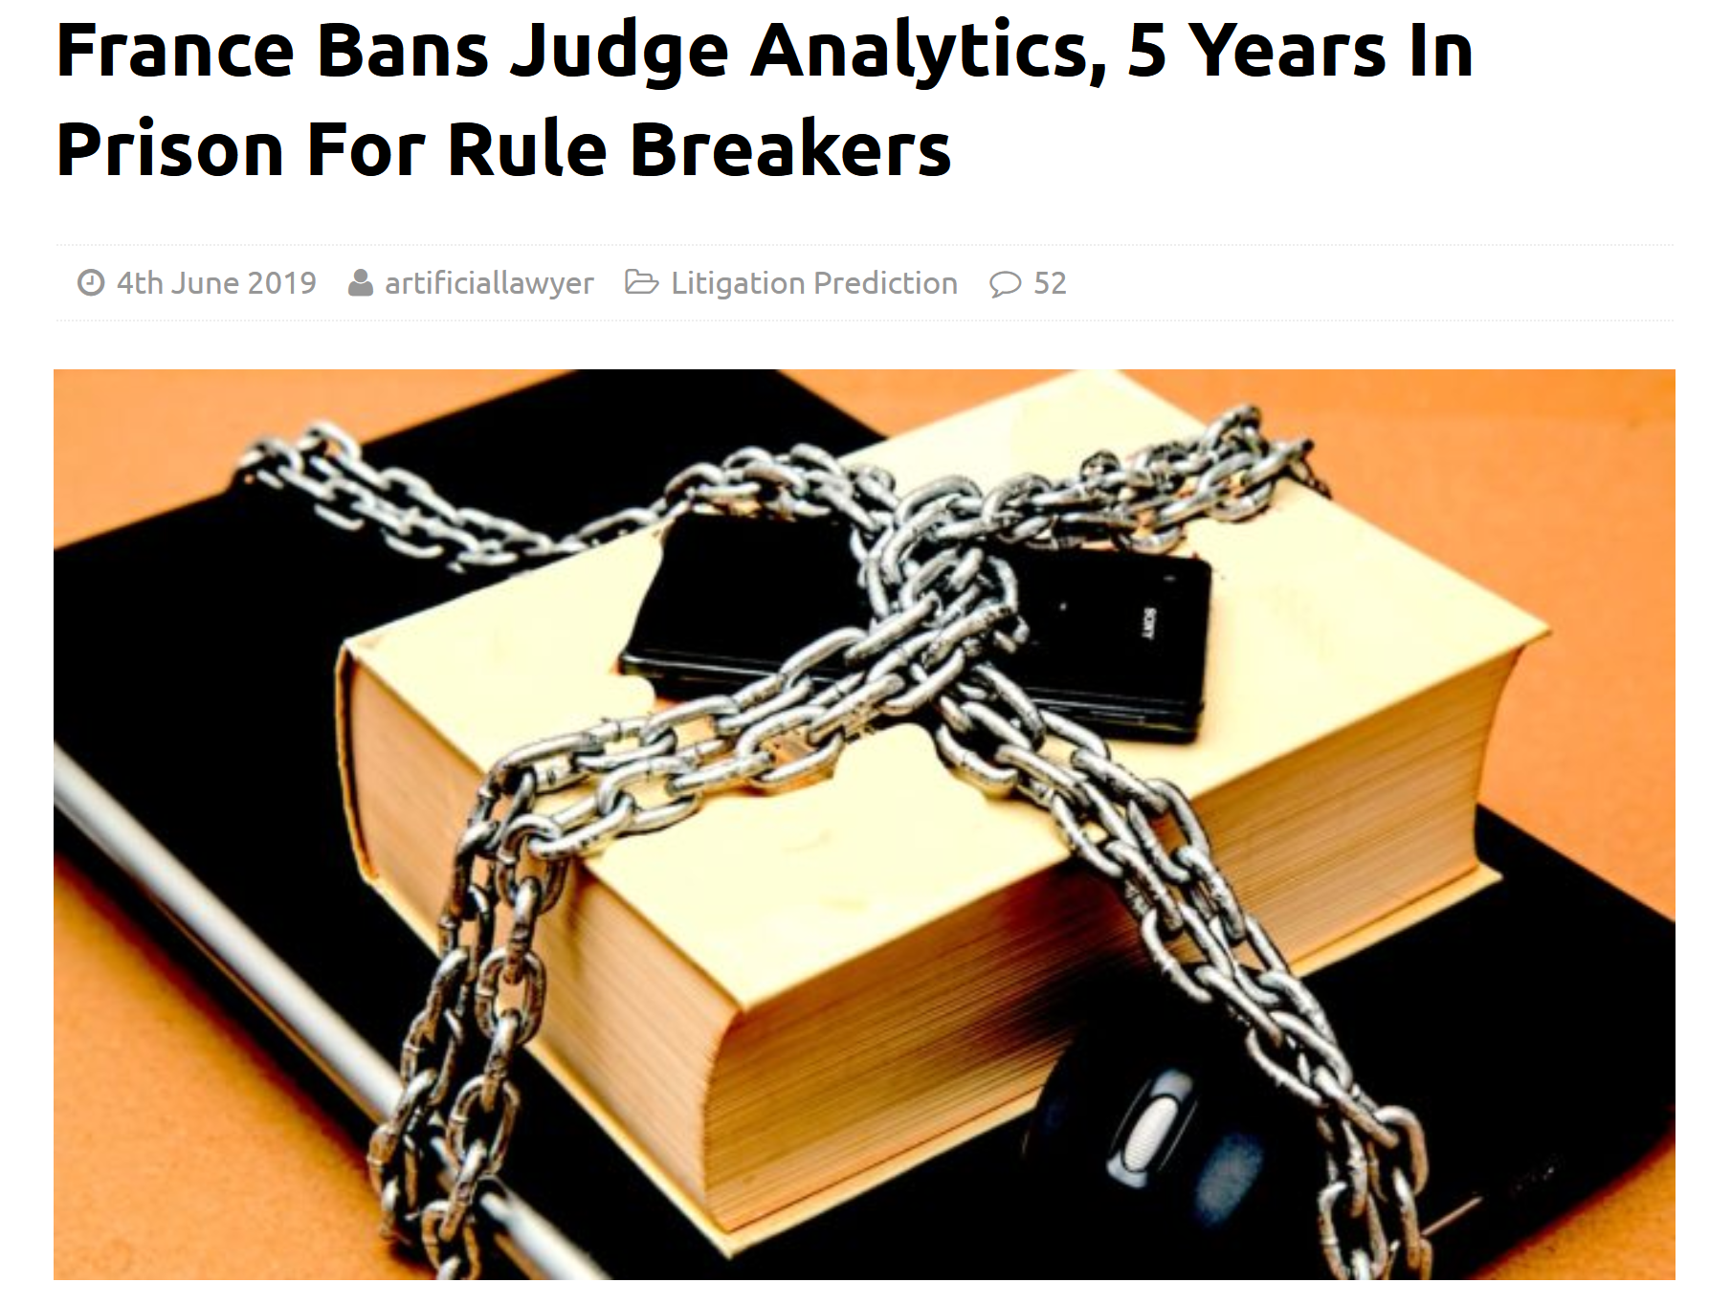

External Analysis of Human Decision Making
https://www.artificiallawyer.com/2019/06/04/france-bans-judge-analytics-5-years-in-prison-for-rule-breakers/

Slide 22
Summary
The ethical and social implications of AI are complex and far-reaching, requiring a concerted effort from technologists, policymakers, ethicists, and society at large to navigate and address these challenges responsibly.

